Slide 1
Recent Trends in IOT
By Dr. Manisha R. Dhage

Slide 2
IOT TECHNOLOGY: A More Connected World
  As machines get smaller, it becomes easier to produce.
  Industries have shifted away from a monolithic, single-device model in favor of a more modular, microservices approach.
  Each device may have its own individual utility as well, and it may benefit the entire network. This is the core of IoT technology.
  IOT TECHNOLOGY’S GROWTH
  According to Mordor Intelligence, the IoT technology market value is expected to rise to $1.39 trillion by 2026.
  Reasons of growth
    The COVID-19 pandemic .
    Businesses are racing to develop better artificial intelligence solutions which requires network of advanced sensors and edge computers.
    IoT networks can accomplish some tasks more efficiently than centralized solutions.
Notes:
The COVID-19 pandemic accelerated the advancement of remote monitoring, smart home devices, and data analysis solutions.
-Businesses are racing to develop better artificial intelligence solutions. These often require a network of advanced sensors and edge computers
within the scope of IoT.
--IoT networks can accomplish some tasks more efficiently than centralized solutions.

Slide 3
Source: Introduction to IOT, NPTEL
Notes:
LoWPAN Gateway (in IoT) - LoWPAN is an acronym of Low power Wireless Personal Area Networks. The LoWPAN IoT gateway functions as a border router in a LoWPAN network, connecting a wireless IPv6 network to the Internet

Slide 4
Source: Introduction to IOT, NPTEL

Slide 5
Source: Introduction to IOT, NPTEL

Slide 6
Source: Introduction to IOT, NPTEL

Slide 7
Source: Introduction to IOT, NPTEL

Slide 8
Source: Introduction to IOT, NPTEL

Slide 9
Source: Introduction to IOT, NPTEL

Slide 10
Implementation IoT with Raspberry Pi
Internet Of Things
Creating an interactive environment
Network of devices connected together

Slide 11
Sensor
Electronic element
Converts physical quantity into electrical signals
Can be analog or digital

Slide 12
Source: Introduction to IOT, NPTEL

Slide 13
Actuator
Mechanical/Electro-mechanical device
Converts energy into motion
Mainly used to provide controlled motion to other components

Slide 14
System Overview
Sensor and actuator interfaced with Raspberry Pi
Read data from the sensor
Control the actuator according to the reading from the sensor
Connect the actuator to a device

Slide 15
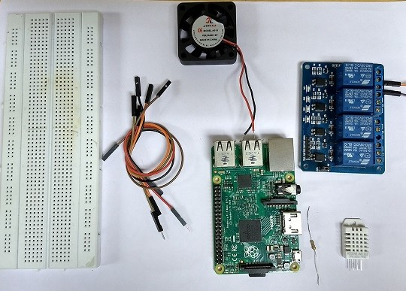
System Overview (contd..)
Requirements
DHT Sensor
4.7K ohm resistor
Relay
Jumper wires
Raspberry Pi
Mini fan

Slide 16
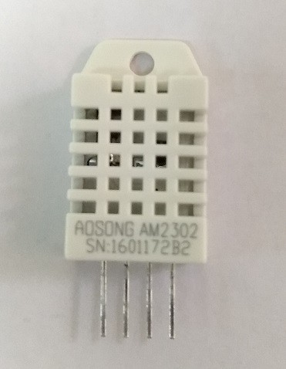
DHT Sensor
Digital Humidity and Temperature Sensor (DHT)
PIN 1, 2, 3, 4 (from left to right)

Slide 17
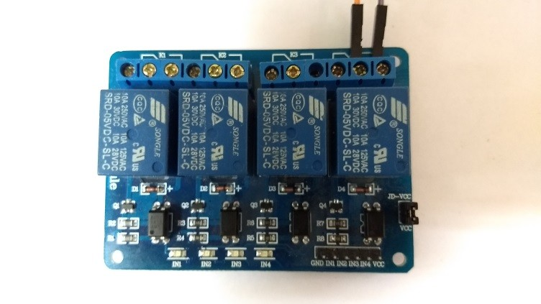
R elay
Relay Board gives your Pi the ability to control high voltage/high current devices
Mechanical/electromechanical switch
3 output terminals (left to right)
  NO (normal open):
  Common
  NC (normal close)

Slide 18
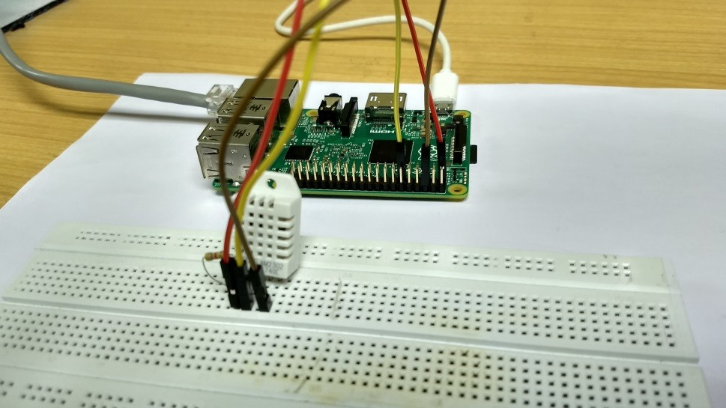
Temperature Dependent Auto Cooling System
Sensor interface with Raspberry Pi
Connect pin 1 of DHT sensor to the 3.3V pin of Raspberry Pi
Connect pin 2 of DHT sensor to any input pins of Raspberry Pi, here we have used pin 11
Connect pin 4 of DHT sensor to the ground pin of the Raspberry Pi

Slide 19
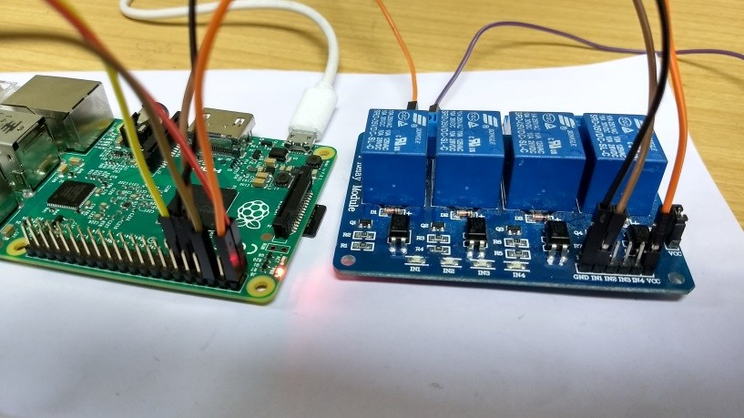
Temperature Dependent Auto Cooling System (contd..)
Relay interface with Raspberry Pi
Connect the VCC pin of relay to the 5V supply pin of Raspberry Pi
Connect the GND (ground) pin of relay to the ground pin of Raspberry Pi
Connect the input/signal pin of Relay to the assigned output pin of Raspberry Pi (Here we have used pin 7)

Slide 20
Temperature Dependent Auto Cooling System (contd..)
Adafruit provides a library to work with the DHT22 sensor
Install the library in your Pi-
  Get the clone from GIT
git clone https://github.com/adafruit/Adafruit_Python_DHT.g...
  Go to folder Adafruit_Python_DHT
cd Adafruit_Python_DHT
  Install the library
sudo python setup.py install

Slide 21
Program: DHT22 with Pi
import RPi.GPIO as GPIO from time import sleep import Adafruit_DHT
#importing the Adafruit library
GPIO.setmode(GPIO.BOARD)
GPIO.setwarnings(False)
sensor = Adafruit_DHT.AM2302
print (‘Getting data from the sensor’)
# create an instance of the sensor type
#humidity and temperature are 2 variables that store the values received from the sensor
humidity, temperature = Adafruit_DHT.read_retry(sensor,17)
print ('Temp={0:0.1f}*C humidity={1:0.1f}%'.format(temperature, humidity))

Slide 22
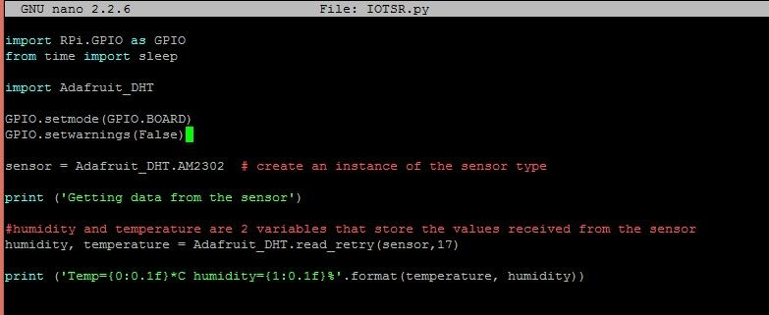

Program: DHT22 interfaced with Raspberry Pi
Code Output

Slide 23
Connection: Relay
Connect the relay pins with the Raspberry Pi as mentioned in previous slides
Set the GPIO pin connected with the relay’s input pin as output in the sketch
GPIO.setup(13,GPIO.OUT)
Set the relay pin high when the temperature is greater than 30
if temperature > 30:
GPIO.output(13,0) # Relay is active low print(‘Relay is on')
sleep(5)
GPIO.output(13,1) # Relay is turned off after delay of 5 seconds

Slide 24
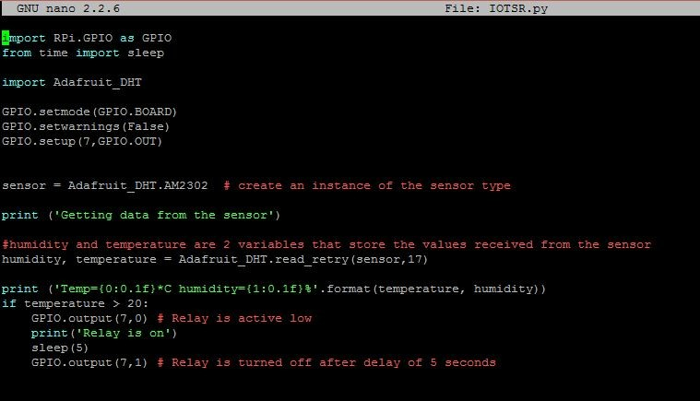
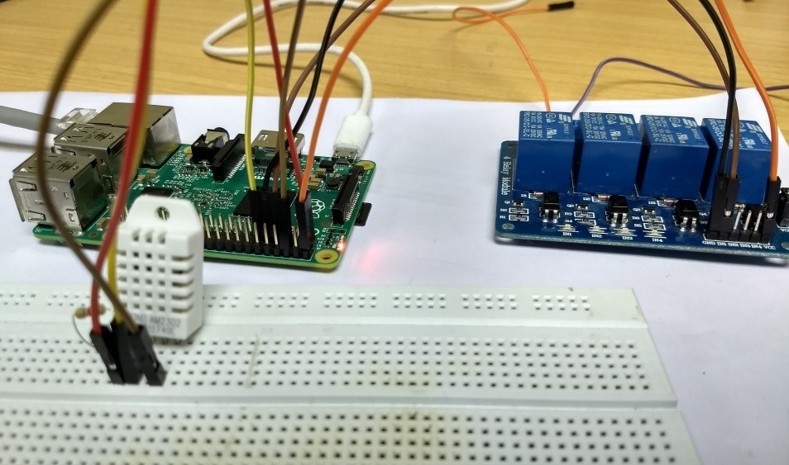
Connection: Relay (contd..)

Slide 25
Connection: Fan
Connect the Li-po battery in series with the fan
  NO terminal of the relay -> positive terminal of the Fan.
  Common terminal of the relay -> Positive terminal of the battery
  Negative terminal of the battery -> Negative terminal of the fan.
Run the existing code. The fan should operate when the surrounding temperature is greater than the threshold value in the sketch

Slide 26
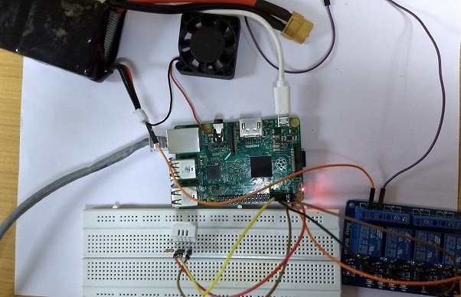
Connection: Fan (contd..)

Slide 27
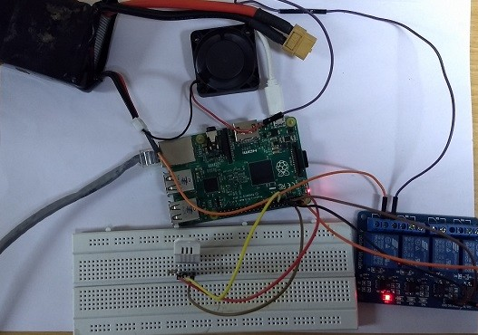
R es ult
The fan is switched on whenever the temperature is above the threshold value set in the code.
Notice the relay indicator turned on.

Slide 28
LIMITED PRODUCTION: THE CHIP SHORTAGE
  Due to high demand and low supply of valuable semiconductor chips, IoT solutions have become more expensive to produce.
  Some businesses are choosing to order their semiconductor inventories far in advance.
  According to Forrester the semiconductor shortage in 2022 will limit the growth of IoT markets by 10 to 15%.
In February of 2022, the European Union passed the European Chips Act, resolve the supply chain shortage.
Notes:
In February of 2022, the European Union passed the European Chips Act, a combination of public and private investments
to support efforts to resolve the supply chain shortage.

Slide 29
Trends

Slide 30
AIoT – Artificial Intelligence & IoT Technology
Artificial intelligence and IoT have a mutualistic relationship.
AI is benefitted by IoT with distributed data, and IoT is benefitted by AI with advanced management.
Network of data
  Research and Markets reports sate that AI in IoT technology will reach a value of $14,799 million by 2026.
  High quality data like live data from IoT sensors important for machine learning
  Ex. predictive maintenance of equipment in factory
VISUAL INSPECTION: AI AND IOT WORK TOGETHER
  Visual inspection is another area where IoT technology and machine learning synergize to enrich industrial and distribution industries.
  https://youtu.be/KezqhMo2P4M
Notes:
----One of the most fascinating use cases of IoT technology is to support artificial intelligence software.
-----Since artificial intelligence technologies are heavily data driven, IoT sensors are an immense asset to the machine learning data pipeline. Research and Markets reports that AI in IoT technology will reach a value of $14,799 million by 2026.
High quality data is extremely important for the success of machine learning techniques.
AI can compound the benefits of IoT by adding human-like awareness and decision-making to the environment at hand to ultimately increase efficiency and improve processes.
For example, live data from IoT sensors monitoring factory equipment can help manufacturing-based machine learning algorithms
determine when equipment needs to be serviced in the future, a practice called
predictive maintenance.

Slide 31
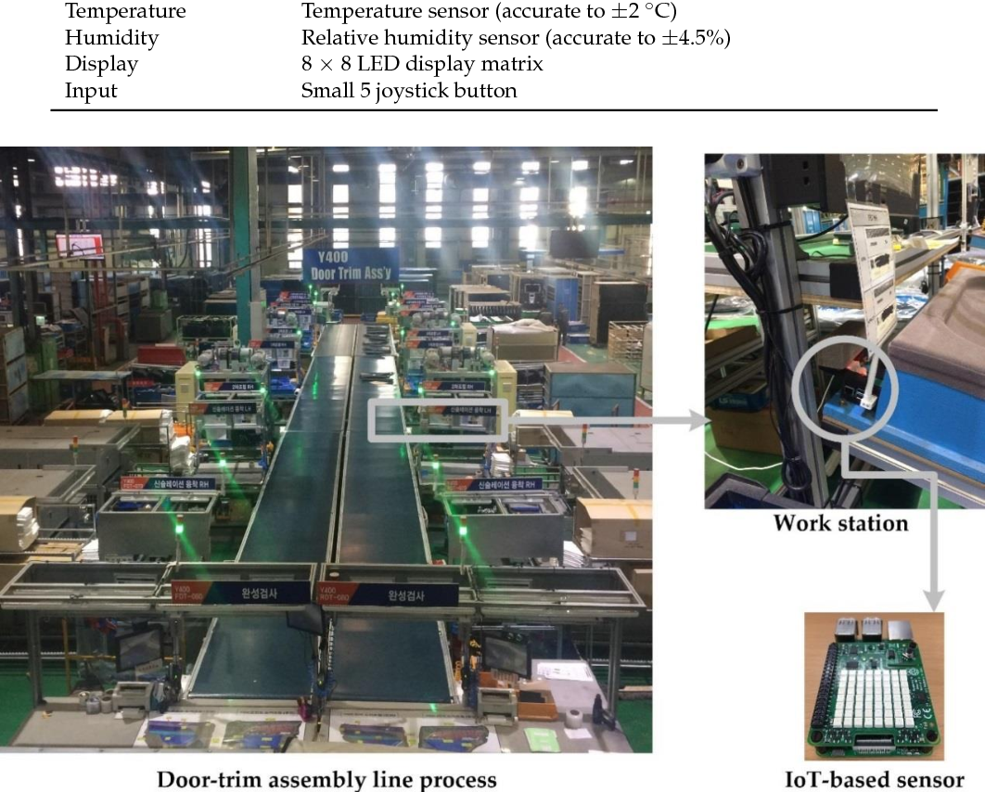

Slide 32
Notes:
Figure 1. Architecture of the real-time monitoring system in an assembly line process (a) and system
design for big data processing (b).
Apache Kafka is a distributed event store and stream-processing platform. for handling real-time data feeds.
Apache Storm has many use cases: realtime analytics, online machine learning, continuous computation, distributed RPC, ETL, and more.

Slide 33
Edge Computing
Edge computing is the ability to collect and analyze data where it is collected.
Low Latency & Security
Ex. financial organizations
Ex. Aautonomous cars
According to Gartner survey currently only 10% data is processed outside traditional data centre or cloud and it will reach 75% by 2025.
Notes:
------One of the top benefits of implementing edge computing is the ability to collect and analyze data where it is collected, catching and correcting problems that might not be identified as quickly if the data were to be sent to a central server or cloud for processing and analysis
-----Real time applications depend on edge computing. Instead of calculating everything at a central source, edge networks process information closer to the
user and lighten the load of the entire network for all users.
Security----If data can be processed on an edge device instead of being transmitted to a central server, there are fewer opportunities for it to be intercepted by hackers.
----ex. A classic example of the application of edge computing is in autonomous cars, where terabytes of data are generated every day and decisions need to be made in milliseconds for a smooth user experience.
---- to maximize operational efficiency, improve performance and safety, automate all core business processes, and ensure “always on” availability.

Slide 34
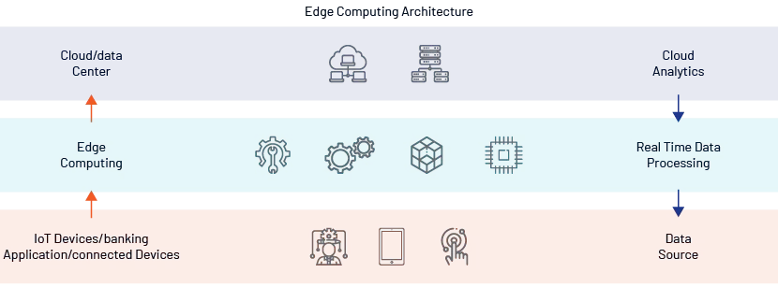

Slide 35

Benefits of Edge Computing
Notes:
safety.– Automatically stopping machinery from operating while someone is in a restricted area at a factory is one way that IoT edge computing can be used to protect people from harm.

Slide 36
Wearable IoT Technology
THE FUTURE OF IOT SMARTWATCHES AND WRISTBANDS
  wearable IoT technology has immense potential to aid in medical roles
  These devices can perform tasks such as automatically alerting others in case of emergencies and gathering of continuous health records.
AR AND VR
  If IoT technology can provide devices with real-time contextual data, then it’s clear how this can greatly benefit the performance of AR and VR devices.
  Ex. Doctors performing surgery aided by head-mounted AR, where wearables and other sensors provide data to the surgeon.
  A distribution center worker using AR on a mobile device to locate the position of an item in a warehouse, where IoT devices help locate the item and send directions to the worker.
  https://youtu.be/I8vYrAUb0BQ
Notes:
---wearable IoT technology has immense potential to aid in medical roles due to its ability to keep track of patient vitals.
----If IoT technology can provide devices with real-time contextual data, then it’s clear how this can greatly benefit the performance of AR and VR devices.

Slide 37
Smart cities and Smart Homes
Introduction
A Smart City is-
  An urban system
  Uses Information & Communication Technology (ICT)
  Makes infrastructure more interactive, accessible and efficient.
Need for Smart Cities arose due to-
  Rapidly growing urban population
  Fast depleting natural resources
  Changes in environment and climate

Slide 38
Analogy
Humans | Smart Cities
Skeleton | Buildings, Industries, People
Skin | Transportation, Logistics
Organs | Hospital, Police, Banks, Schools
Brain | Ubiquitously embedded intelligence
Nerves | Digital telecommunication networks
Sensory Organs | Sensors, Tags
Cognition | Software

Slide 39












Application Focus Areas
Smart Economy
Competitiveness
Smart Governance
Citizen participation
Smart People
Social and Human Capital
Smart Mobility
Transport and ICT
Smart Environment
Natural resources
Smart Living
Quality of life

Slide 40
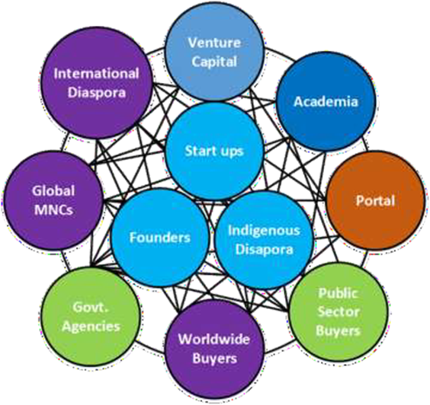
Smart Economy

Slide 41
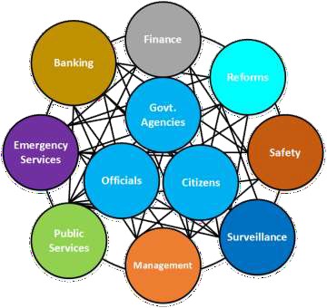
Smart Governance

Slide 42
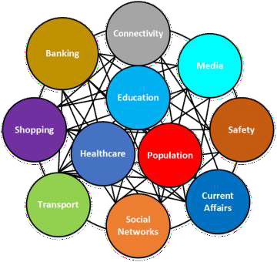
Smart People

Slide 43
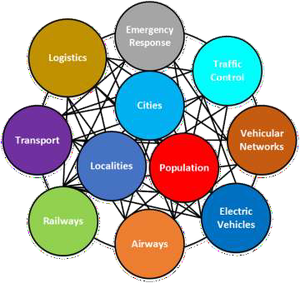
Smart Mobility

Slide 44
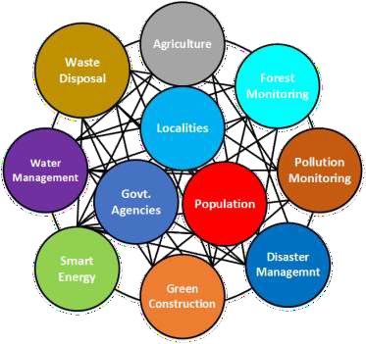
Smart Environment

Slide 45
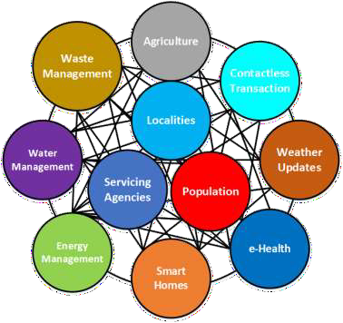
Smart Living

Slide 46
Current Focus Areas
Smart Homes
  Health monitoring.
  Conservation of resources (e.g. electricity, water, fuel).
  Security and safety.
Smart Parking Lots
  Auto routing of vehicles to empty slots.
  Auto charging for services provided.
  Detection of vacant slots in the parking lot.

Slide 47
Current Focus Areas (contd.)
Smart Vehicles
  Assistance to drivers during bad weather or low-visibility.
  Detection of bad driving patterns or driving under the influence of substances.
  Auto alert generation during crashes.
  Self diagnostics.
Smart Health
  Low cost, portable, at-home medical diagnosis kits.
  Remote check-ups and diagnosis.
  On-body sensors for effortless and accurate health monitoring.
  Auto alert generation in case of emergency medical episodes (e.g. Heart attacks,
seizures).

Slide 48
Current Focus Areas (contd.)
Pollution and Calamity Monitoring
  Monitoring for weather or man-made based calamities.
  Alert generation in case of above-threshold pollutants in the air or water.
  Resource reallocation and rerouting of services in the event of calamities.
Smart Energy
  Smart metering systems.
  Smart energy allocation and distribution system.
  Incorporation of traditional and renewable sources of energy in the same
grid.

Slide 49
Current Focus Areas (contd.)
Smart Agriculture
  Automatic detection of plant water stress.
  Monitoring of crop health status.
  Auto detection of crop infection.
  Auto application of fertilizers and pesticides.
  Scheduling harvesting and arranging proper transfer of harvests to warehouses or markets.

Slide 50








Technological Focus Areas
Data Collection
Mobile devices, Sensors, Architecture
Data Transmission
Radios, Networking, Topologies
Data Storage
Local storage, Data warehouses
Data Processing
Data cleaning, Analytics, Prediction

Slide 51
IoT Challenges in Smart Cities
Security and Privacy
  Exposure to attacks
  Exposure to vulnerabilities .
  Multi-tenancy induces the risk of data leakage.
Heterogeneity
  Integration of varying hardware platforms and specifications.
  Integration of different radio specifications.
  Integration of various software platforms.
  Accommodating varying user requirements.

Slide 52
IoT Challenges in Smart Cities (contd.)
Reliability
  Unreliable communication due to vehicle mobility.
  Device failures still significant
Large scale
  Delay due to large scale deployments.
  Delay due to mobility of deployed nodes.
  Distribution of devices can affect monitoring tasks.

Slide 53
IoT Challenges in Smart Cities (contd.)
Legal and Social aspects
  Services based on user provided information may be subject to local or
international laws.
  Individual and informed consent required for using humans as data
sources.
Big data
  Transfer, storage and maintenance of huge volumes of data is expensive.
  Data cleaning and purification is time consuming.
  Analytics on gigantic data volumes is processing intensive.
Source: Arasteh, H., et al. "Iot-based smart cities: A survey." IEEE 16th International Conference on Environment and Electrical
Engineering (EEEIC), 2016.

Slide 54
IoT Challenges in Smart Cities (contd.)
Sensor Networks
  Choice of appropriate sensors for individual sensing tasks is crucial.
  Energy planning is crucial.
  Device placement and network architecture is important for reliable
end-to-end IoT implementation.
  Communication medium and means play an important role in
seamless function of IoT in smart cities .

Slide 55


